Slide 1

Spring 2023
Simulation model for biomanufacturing process
Simulation Analysis | 2023

Slide 2
Why?
With the COVID-19 hitting the world, the importance and urgency of drug manufacturing has grown at a massive scale.
Introduction
What?
We aim to develop a simulation model to study and observe methods to reduce batch-to-batch variability in protein level, impurity level, and production cycle time in the biopharmaceutical production process.
Simulation Analysis | 2023

Slide 3
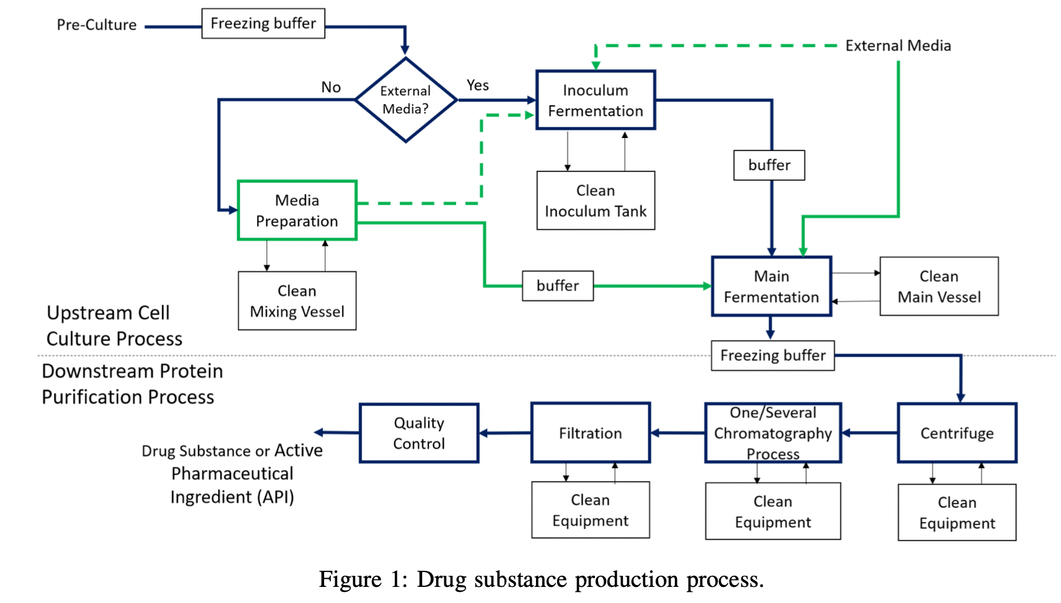
Original Drug Substance Production Process
Simulation Analysis| 2023

Slide 4
Simulation Modelling
We simplify the production process analysis and focus on the batch-to-batch variation in Protein Levels, impurity, and production cycle time
We will focus on end-to-end risk analysis of the production process to identify and mitigate risks that may affect these key parameters.

Slide 5
Process Simplifications
We consider the following for our processes:
Use of External Media (Antigen A) and no internally produced media (Antigen B)
After Main Fermentation, proceed directly to the Downstream Protein Purification Process (DSP)
Removal of cleaning stages for both USP and DSP
Removal of multiple Chromatography steps
No final Quality Control stage
Removal of No-Wait constraints
Simulation Analysis | 2023

Slide 6
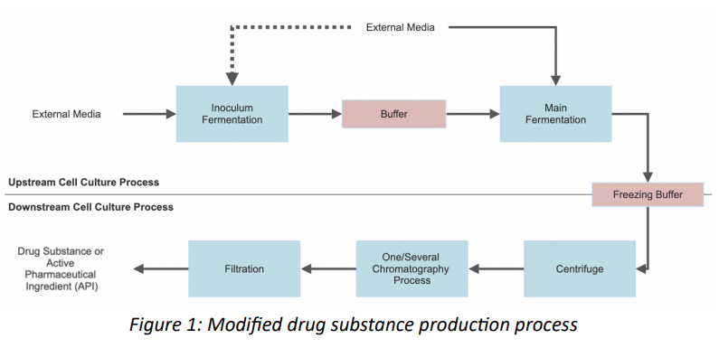
Simplified Drug Substance Production Process
These main steps that we focus on include:
(1) Pre-culture and expansion
(2) Fermentation and harvest
(3) Centrifugation(s)
(4) Chromatography/purification
(5) Filtration.

Slide 7
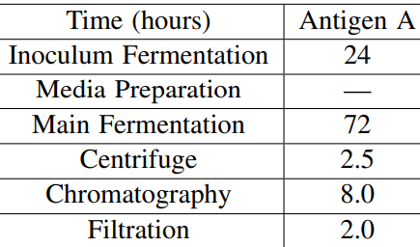
Simulation Modelling
Number of Equipment or Capacity
(5, 2) and (8, 4)
Inoculum Tank (5) (8)
Main Tank (5) (8)
Centrifuge (2) (4)
Chromatography(5) (8)
Filtration (2) (4)

Slide 8
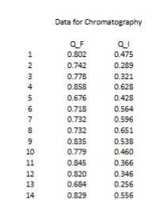
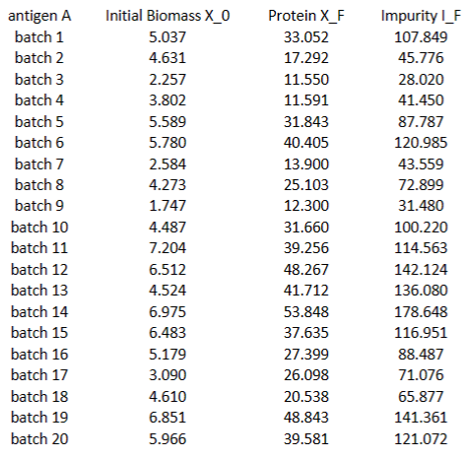
Data
Data from Wang Et al.
Starting biomass (20 batches)
Protein level after the Main fermentation for 20 batches
Mean Proportion for Protein and Impurity For chromatography

Slide 9
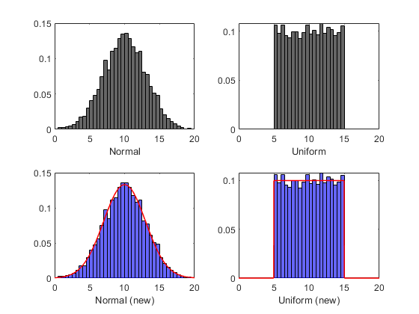
Input Modelling
AIC (lower the better)
K-S Statistic (higher p-value preferred)
A-D statistic (higher p-value preferred)
Q-Q Plot (closer to 45 degree line)

Slide 10
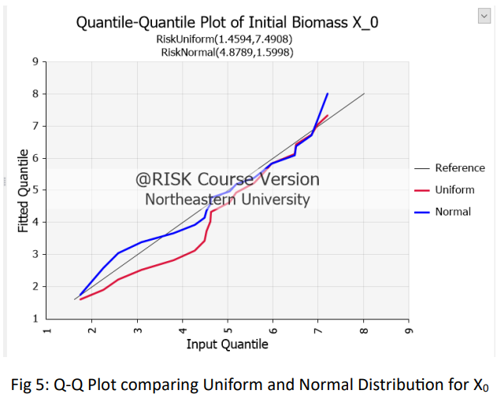
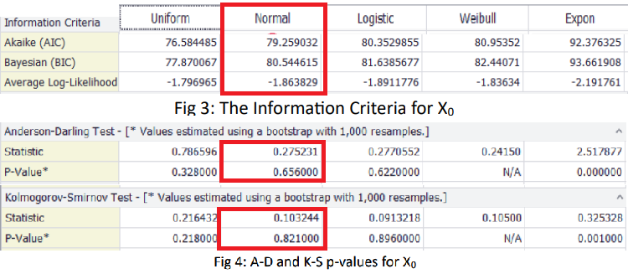
Initial Biomass
Based on the p-value of the K-S statistic and domain knowledge, the normal distribution is chosen to be the best fit distribution for modelling X0 with mean 4.89 , and variance (1.60)**2

Slide 11



Main Fermentation
Parameters μ and ε_{P} determined by fitting Linear Regression to log transformation
Distribution of ε_{P} ~ Normal (0, 0.27²) and μ ~ 1.8
ε_{I} ~ Normal (0, 0.27²)
Centrifuge
Protein Level doesn’t change
Removes random proportion of impurity , Q ~ Unif(0.4, 0.5)

Slide 12
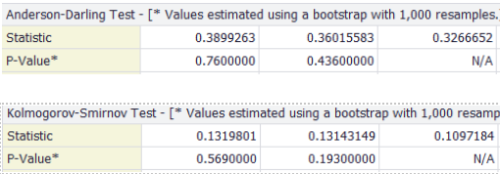
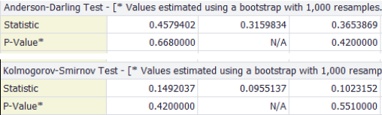
Chromatography
X_{P} = Q_{P}·X_{C} and I_{P} = Q_{I}·I_{C}
A-D and K-S p-values for Q_{P}
A-D and K-S p-values for Q_{I}
Q_{P} ~ Unif (0.66, 0.92) and Q_{I} ~ Unif (0.25, 0.67)
Filtration
I_{Fr} = Q_{Fr}.I_{P} with Q _{f r} ∼ Unif(0.99, 1) and filtration doesn’t affect Protein Levels

Slide 13
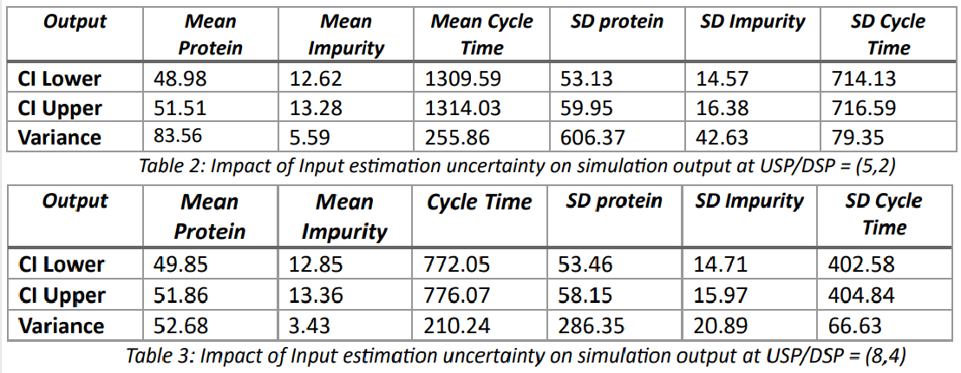
Input Uncertainty Quantification &
Output Analysis
Using our calculated batch-to-batch means of protein/impurity level, we record the 95% CI lower/upper bounds and bootstrap variance as follows:
With (8, 4) we observe a lower Cycle time and less variation in the impurity levels of batches

Slide 14
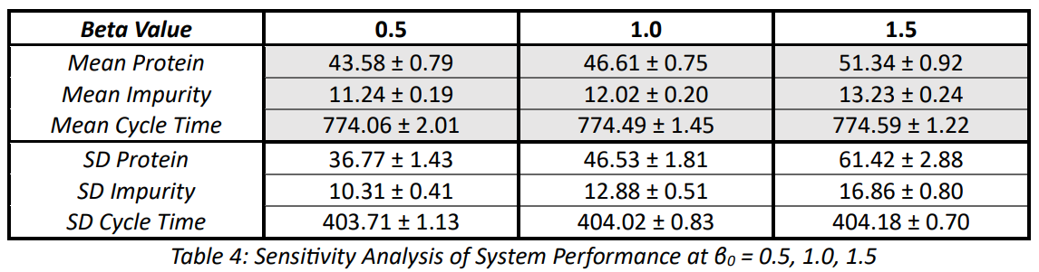
Sensitivity Analysis on System Performance
System Performance observed at 3 β levels: [0.5, 1.0, 1.5] (where β=σ_i/ σ_p)
Variation increases with increasing β
Lower β = more likely to pass γ (Quality Control Threshhold)

Slide 15
Model validation
To validate, we used a Jackson Network with exponential distributions for inter-arrival times and processing time.
Estimated total cycle time 95% confidence intervals:
USP/DSP = (5,2)
Simulated Network = [1309.59, 1314.03]
Jackson Network = [1084.91, 1269.25]
USP/DSP = (8,4)
Simulated Network = [772.05,776.07]
Jackson Network = [689.66, 804.81]

Slide 16


Discussion
Considering impacts to batch-to-batch variability and cycle times, our study shows
Equipment Variability
Starting Material Variability (Antigen A/Antigen B)
Process Variability (buffers composition, pH values)
Operator Variability (SOP’s, operator experience)
Environmental Variability (temperature, humidity)
Analytical Variability (calibration)

Slide 17
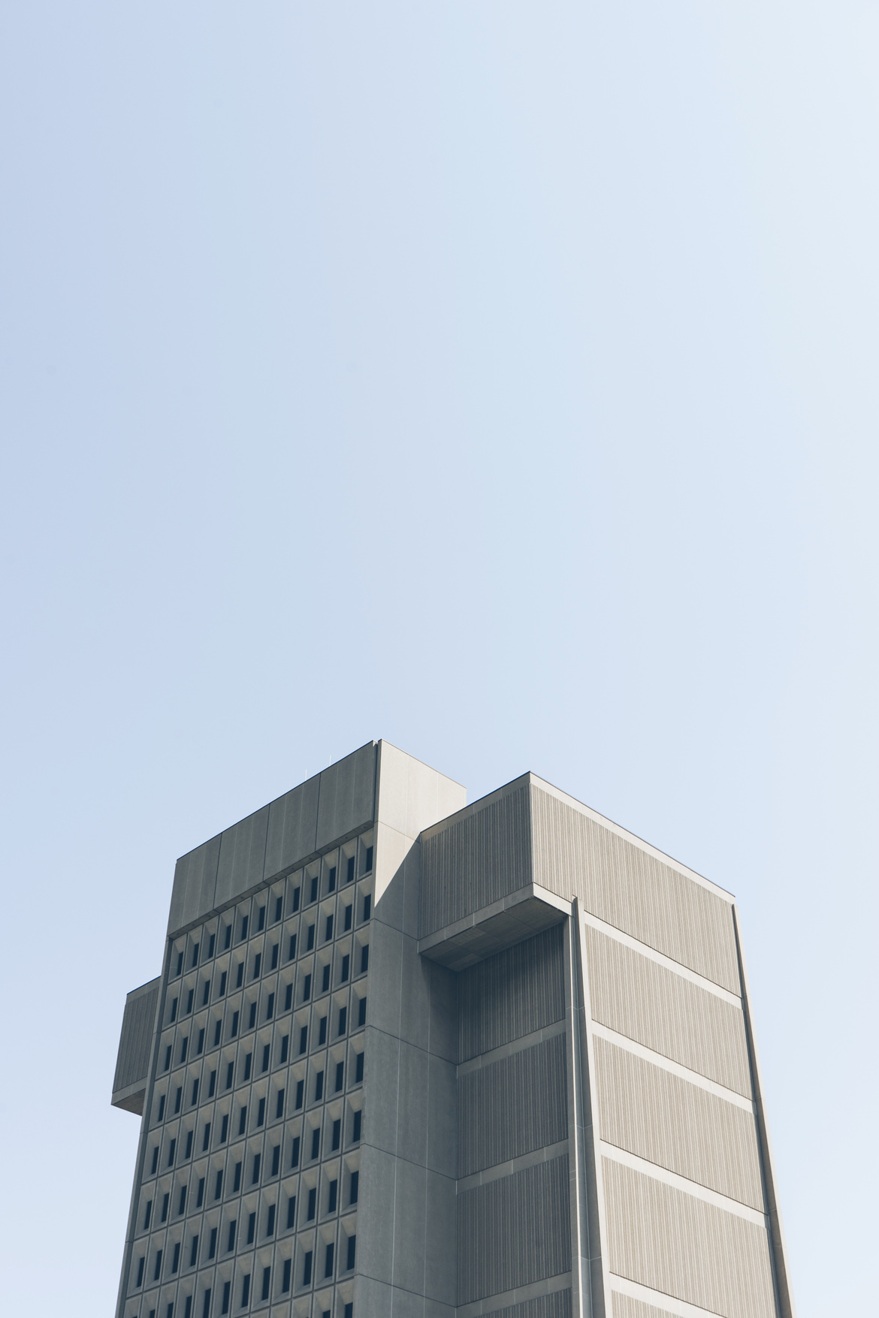
Group 5
Simulation Analysis | 2023
Thank you!

